Slide 1
Organic pharmaceutical chemistry

Slide 2
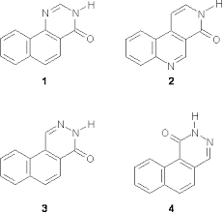
Organic chemistry: Organic chemistry is the scientific study of the structure, properties, composition, reactions, and synthesis of organic compounds (molecules composed of carbon, hydrogen, and may contain any number of other elements like nitrogen,
oxygen and halogens).

Slide 3
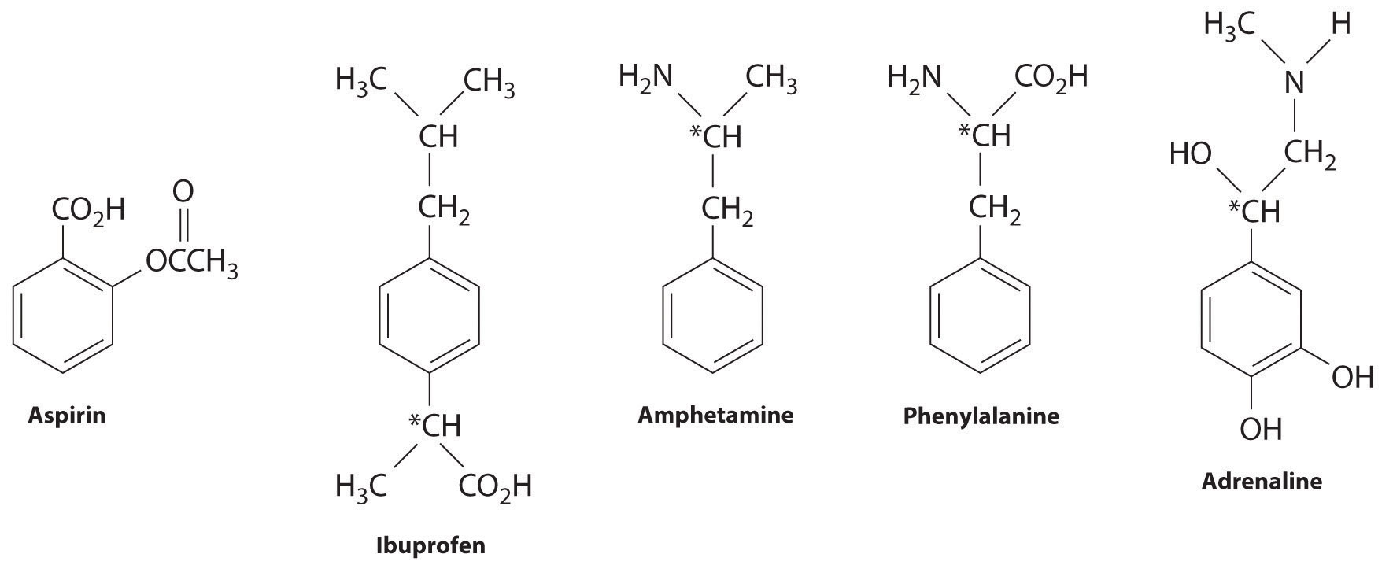
Organic pharmaceutical chemistry is the study of drugs, and it involves drug development. This includes drug discovery, delivery, absorption, metabolism, and more.

Slide 4
Aim of this lab: synthesis of known drugs like aspirin, phenytoin, paracetamol…etc, through a suitable reactions depending on drug’s molecular structure and the available chemicals and tools.

Slide 5
Chemical reactions
Most molecules are at peace with themselves. Bottles of sulfuric acid, sodium hydroxide, water, or acetone can be safely
stored in a laboratory cupboard
for years without any change in
the chemical composition of
the molecules inside.

Slide 6
Reactions happen when electrons flow between molecules
When pair of molecules find themselves close together, a reaction can take place provided electrons move from one molecule to another. This is what we call the mechanism of the reaction (the detailed description of the pathway the electrons take).
The molecule that accepts the electrons is called the electrophile (electron-lover).
The molecule that donates the electrons is called the nucleophile.

Slide 8
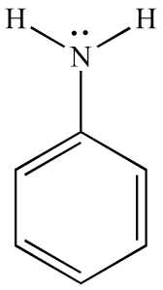
Identifying a nucleophile
Neutral nucleophiles with lone pairs of electrons, typically: ammonia, amines, water, and alcohols, all of which have lone pairs (one for N, two of equal energy for O).

Slide 9
The arrow starts on the lone pair

Slide 10
Negatively charged nucleophiles are often good nucleophiles too, partly because they can be attracted electrostatically by positively charged electrophiles. The anionic centre is usually O, S, or halogen. For example, hydroxide.

Slide 11
The arrow starts on the hydroxide’s negative charge, which represents one of the oxygen’s pairs of electrons

Slide 12
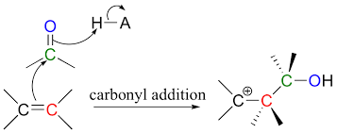
Bonding π orbitals, especially C=C double bonds, since they are higher in energy than σ orbitals. The only common π nucleophiles are alkenes and aromatic rings.

Slide 13
Identifying an electrophile
Neutral electrophiles with an empty atomic orbital that can easily accept electrons, such as boron trifluoride and aluminium trichloride.

Slide 15
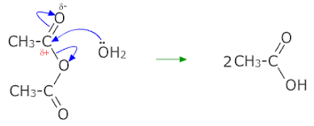
Positively charged electrophile like carbonyl group. There is a partial positive charge on the carbon and a partial negative charge on the oxygen, because oxygen is more electronegative than carbon. So the oxygen pulls electrons towards itself.

Slide 16
Curly arrow
A curly arrow represents the movement of a pair of electrons from a filled orbital into an empty orbital. The result of this movement is to form a bond between a nucleophile and an electrophile.

Slide 17
Arrow to make new bond

Slide 18
Arrow to break an old bond

Slide 19
Example
Electrons flow from the nucleophile (NH3) to the electrophile
(BH3) and a new bond is formed.

Slide 20
Chemistry Laboratory Safety Rules
Always Follow the Instructions.
Do Not Pipette by Mouth - Ever​.
Read the Chemical Safety Information. A Material Safety Data Sheet (MSDS) should be available for every chemical you use in the lab.
Don't Taste or Sniff Chemicals
Dress Appropriately (include a lab coat, safety goggles and gloves).

Slide 21
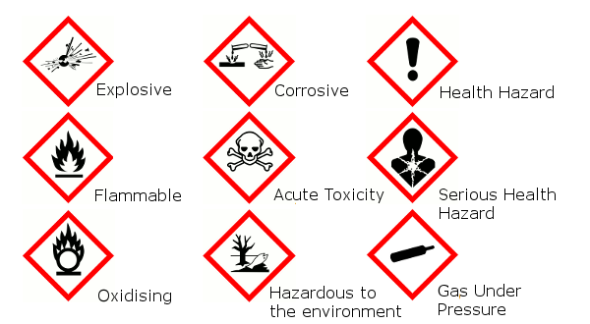
Hazard symbols

Slide 22
Home work
1-
2-

Slide 23
3-

